Slide 1
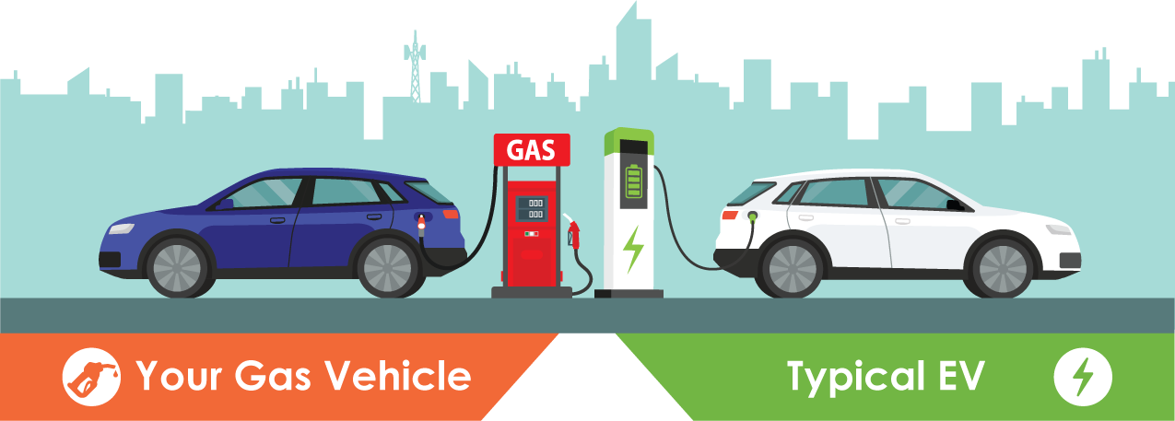
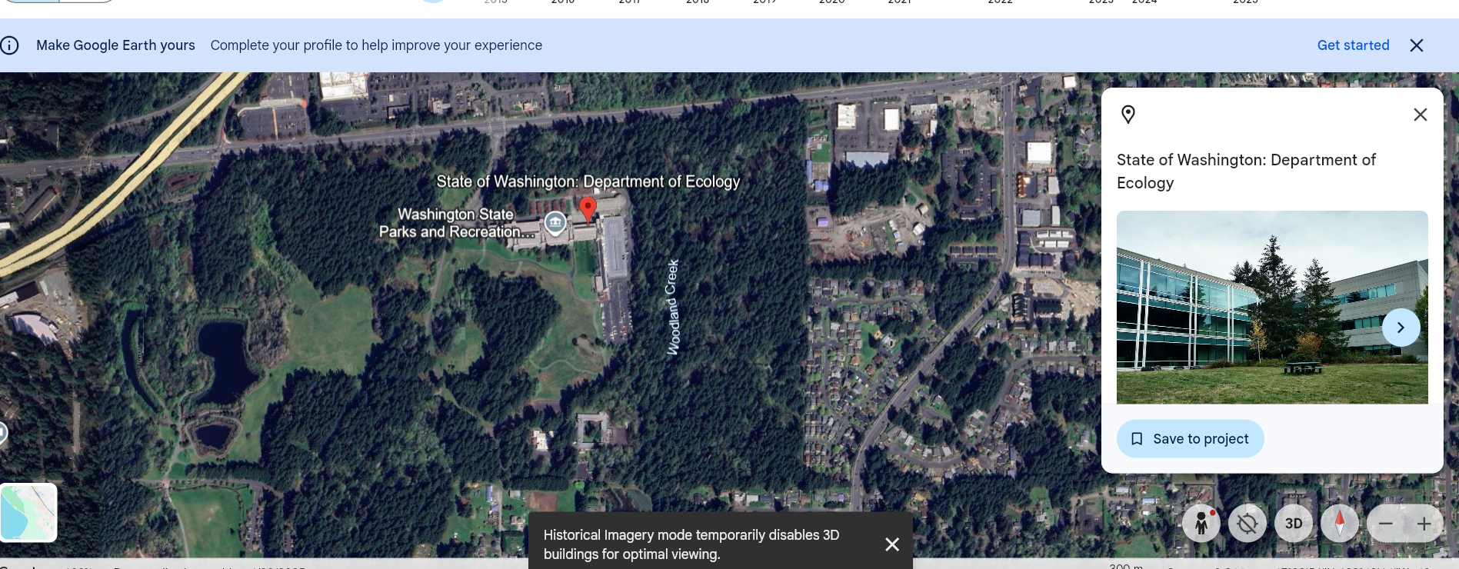
Data Visualization Bioinformatics and Data Science Dr. Namita Mishra
EV Vehicles and Benefits
Carbon Footprint
Saving Energy
Health

Slide 2
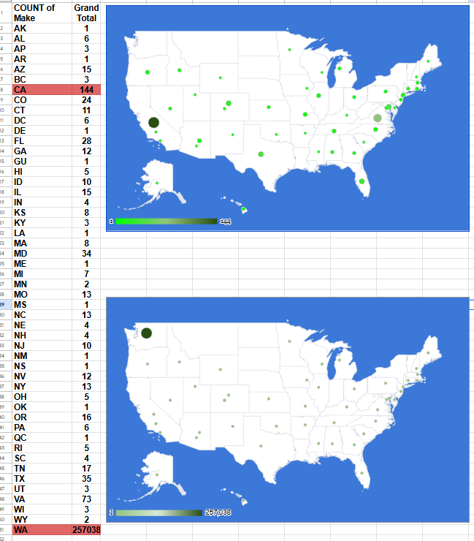

How to correctly manage, visualize, and interpret the data? HINT - Watch out for the outliers in the City data on registered EV vehicles (EV cities per 100,000 people)
Excluding (WA), the highest number of EVs registered
State name with the highest number of EVs registered in WA?
*The top two cities highlighted in red (dataset)
Number of Battery Electric Vehicles (BEVs) and Plug-in Hybrid Electric Vehicles (PHEVs) currently registered through the Washington State Department of Licensing (DOL)
Interactive map
EV – States in the US

Slide 3
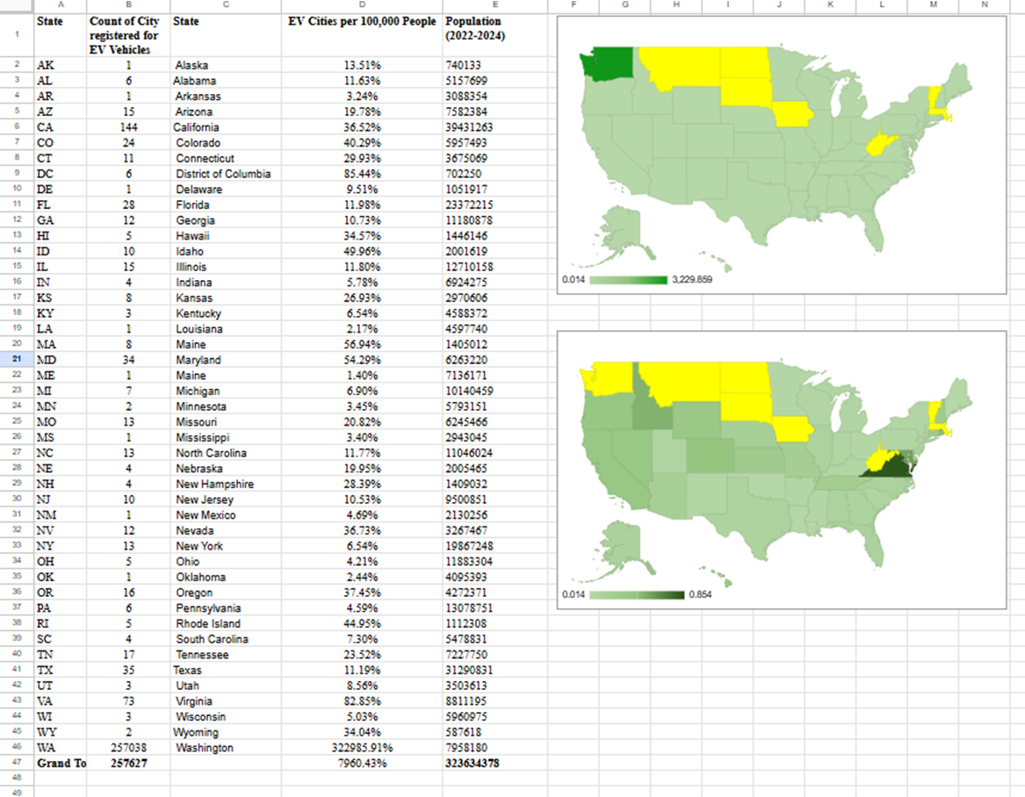
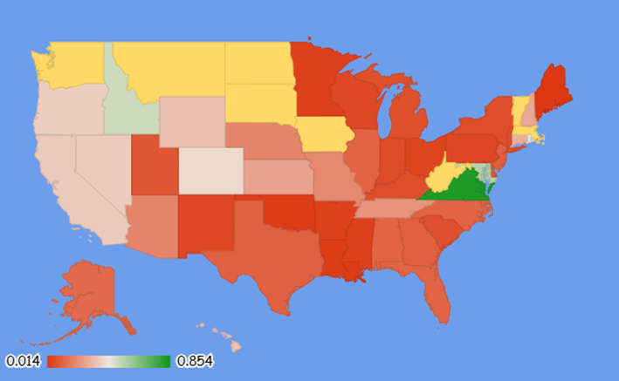
Which states could implement interventions for fewer carbon emissions?
Interventions *Zero-Emission Vehicle (ZEV) program *Financial Investment *Policies
COUNTS
Battery Electric Vehicles
BEVs
Plug-in Hybrid Electric Vehicles (PHEVs)
Washington (WA and CA - Amongst the top 4 states with the largest no. of EV vehicles registered
Yellow - Missing data
Excluding (WA and CA)
PROPORTION
EVs/10000 population
References
Population statistics: https://en.wikipedia.org/wiki/List_of_U.S._states_and_territories_by_population
Data.gov: https://data.wa.gov/

Slide 4
References and Benefits of EV Vehicles
Population data - Extracted online (https://data.gov/)
EV data extracted from
Electric_Vehicle_Population_Data:https://catalog.data.gov/dataset/electric-vehicle-population-data
Benefits of EV Vehicles
(1) Zero exhaust pollutants (NOx, CO₂, particulate matter) (2) Renewable energy (solar, wind, hydro)- carbon footprint is near zero (3) Reduce urban air pollution- Respiratory Diseases and Cancer (4) EVs emit less CO₂
THANKS

